Slide 1

Differences between casual and annual members riders using Cyclistic bikes which can help turning casual into annual members
2022-12-25
Slinae Lin

Slide 2
Goals Discussion Today
Differences of following features from Time session of the day , Weekday, Month
Counts Distribution
Ride Length
Ride Distance
Addition discussion : Start station difference and End station difference

Slide 3
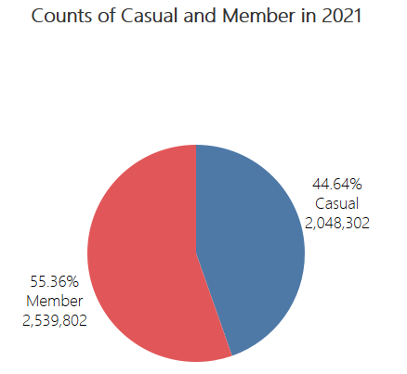
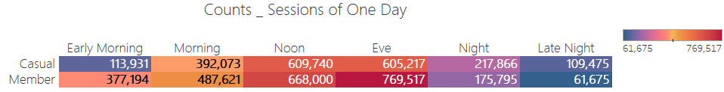
Counts Distribution
Dataset : Historical dataset in 2021 from Cyclistic company to help turning casual to member.
Total data item: 4,588,104

Slide 4
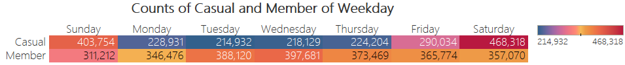
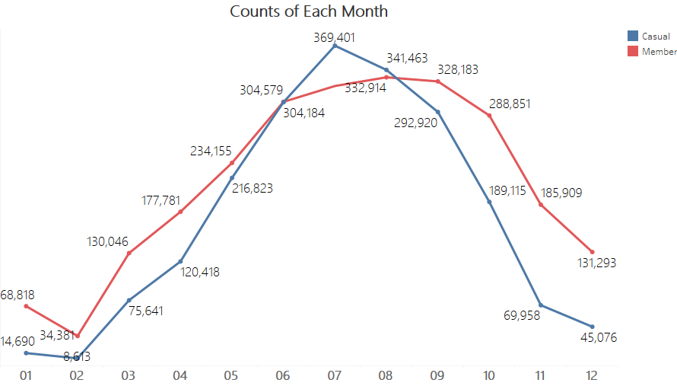
Counts Distribution

Slide 5
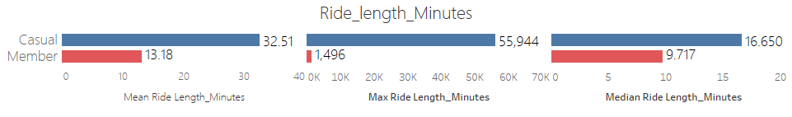
Ride Length Difference

Slide 6
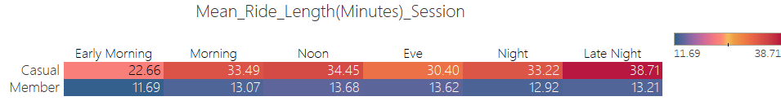
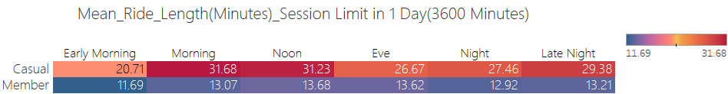

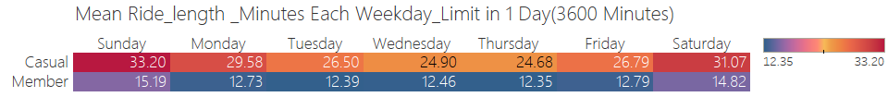
Ride Length Difference

Slide 7
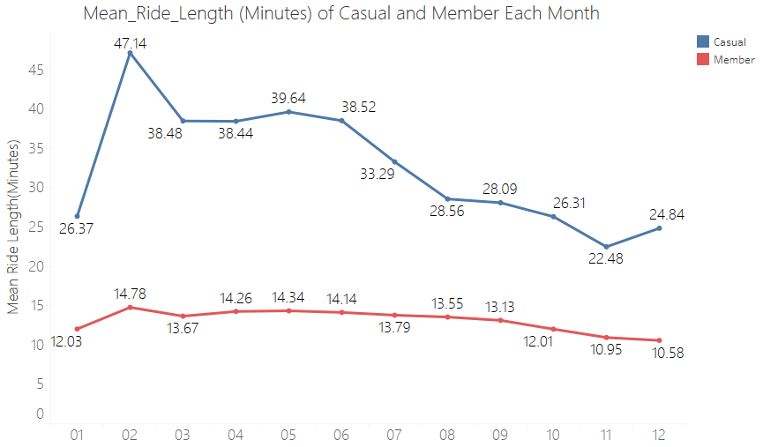
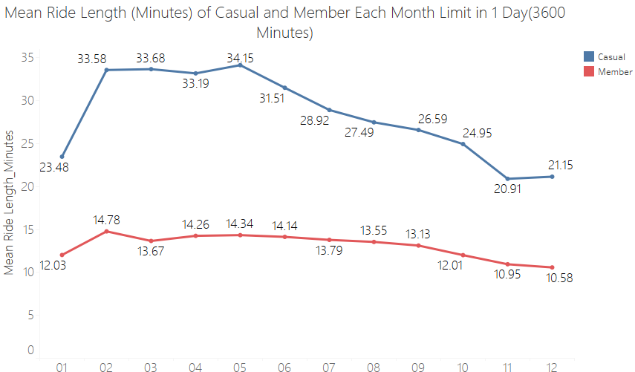
Ride Length Difference

Slide 8
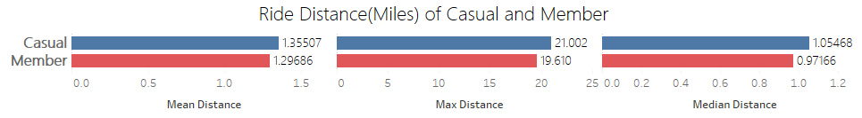
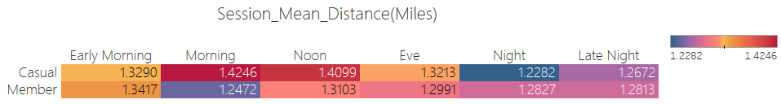
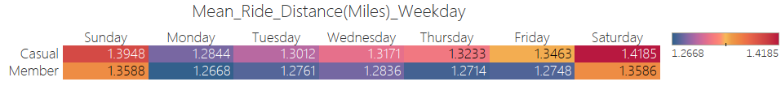
Ride Distance Difference

Slide 9
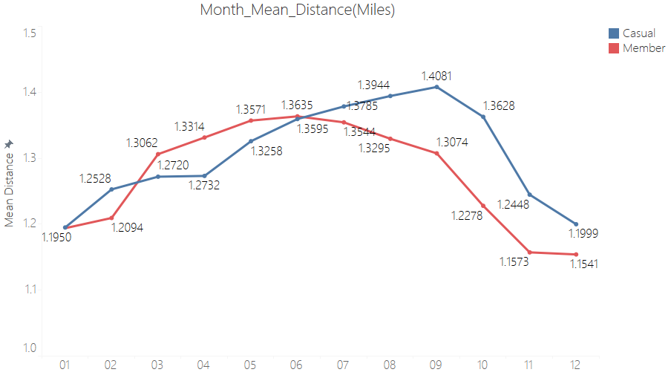
Ride Distance Difference

Slide 10
Start Station Difference
Top 10 start station for the casual different from top 10 start station for the member
Top 10 Start Station for the Casual | Top 10 Start Station for the Member
13022 | TA1307000039
13300 | TA1308000050
13008 | KA1503000043
LF-005 | KA1504000135
13042 | 13045
15544 | 13016
TA1308000001 | TA1306000012
TA1308000050 | LF-005
13179 | 13137
SL-005 | TA1305000032

Slide 11
End Station Difference
Top 10 end station for the casual different from top 10 end station for the member
Top 10 End Station for the Casual | Top 10 End Station for the Member
13022 | TA1307000039
13008 | TA1308000050
LF-005 | KA1503000043
13300 | KA1504000135
13042 | 13045
TA1308000001 | LF-005
15544 | 13016
TA1308000050 | TA1306000012
TA1307000117 | 13137
13179 | TA1305000032

Slide 12
Conclusions and Suggestions
Conclusions:
More member than casual
More casual at night and late night and on Sunday and Saturday, in the summer.
The mean ride length of the casual is more than twice than the member.
The mean ride length for casual are change more, from nearly 20 minutes to 40 minutes, and longer at late night, on Saturday and Sunday. It is more stable for the member from 11 minutes to 15 minutes, longer on Saturday and Sunday. Both casual and the member ride longer length in the first half of the year.
The ride distances for the casual and the member are close.
The 10 most popular start station and end station for the casual and member are different.
Some Suggestions for action:
Social media to understand more about casual
Email marketing and social media to promote casual ride more at non weekend, encourage them ride shorter time length.

